Slide 1
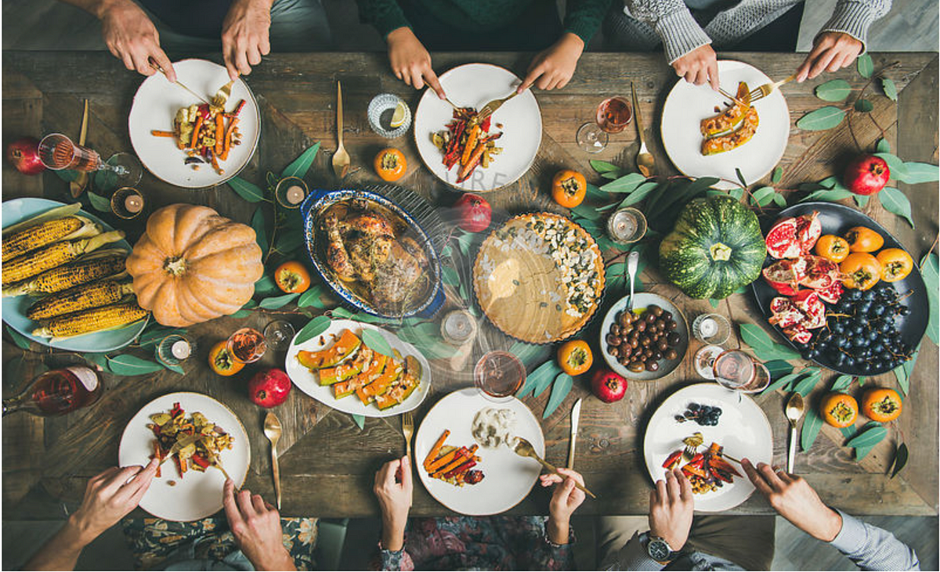
Advanced Diet Recommendation System
Team : Prasad Vaydande Sumegh Bansode Piyush Raut Omkar Ghankute
Guide:
DR. A.M.Patokar

Slide 2
A balanced diet is essential for maintaining overall health and well-being. Proper nutrition helps in: ✔ Reducing the risk of chronic diseases such as heart disease, diabetes, and hypertension. ✔ Maintaining cholesterol levels, supporting heart health. ✔ Boosting immunity and improving overall energy levels. ✔ Enhancing metabolism, weight management, and digestive health. Among these, cardiovascular health is directly impacted by dietary habits, making personalized diet recommendations crucial for people with high cholesterol or other lipid imbalances.
Introduction

Slide 3

Challenges in Personalized Diet Recommendations Despite the availability of general dietary guidelines, personalized nutrition faces several challenges: Generic Diet Plans: Many diet plans are one-size-fits-all, ignoring individual health metrics (e.g., cholesterol levels, age, gender). Difficult Interpretation of Medical Reports: Most people are not medically trained to understand cholesterol reports and their implications. Lack of Accessibility: Consulting a nutritionist or dietitian can be time-consuming and expensive. Manual Analysis is Inefficient: Doctors and nutritionists must manually assess reports, which is not Scalable for larger populations.

Slide 4
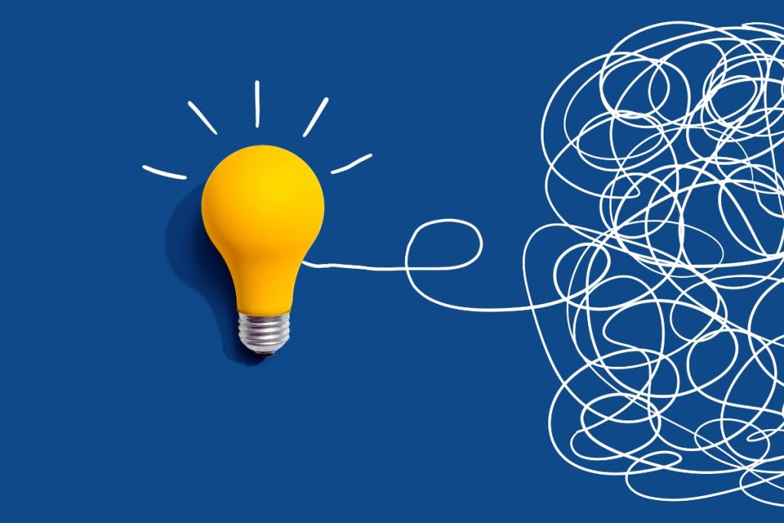
Why This Project? This project solves the above challenges by developing an AI-driven diet recommendation system that: ✅ Extracts cholesterol and other health data from medical reports automatically. ✅ Uses machine learning to generate personalized diet plans tailored to the user’s cardiovascular health. ✅ Provides instant results via a user-friendly web app, making dietary advice more accessible. ✅ Reduces dependency on manual consultations, ensuring faster and more efficient dietary recommendations. This system will empower individuals to make informed dietary choices, ultimately improving their health outcomes.

Slide 5
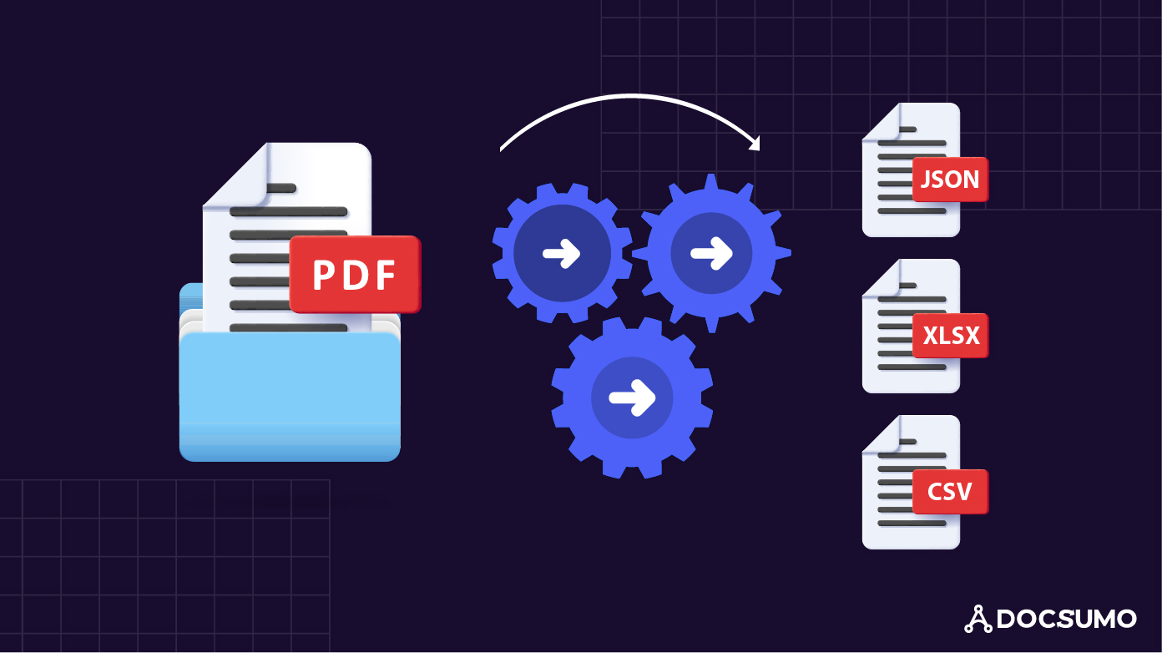
A. Text Extraction from Medical Reports (PDF Processing) Goal: Extract cholesterol values (Total Cholesterol, LDL, HDL, Triglycerides) from medical reports. Methods Used: 1. For Digital PDFs: Use PyMuPDF and PDFMiner to extract structured text. 2. For Scanned PDFs (Images in PDFs): Use OCR (Tesseract, EasyOCR) to recognize text. 3. Preprocessing the Extracted Data: Use Natural Language Processing (NLP) to clean, filter, and standardize cholesterol data. Example - Extracted Data Total Cholesterol: 210 mg/dL HDL Cholesterol: 45 mg/dL LDL Cholesterol: 140 mg/dL Triglycerides: 180 mg/dL
Project Components

Slide 6
🔹 Goal: Classify users into different diet categories based on their cholesterol levels. 🔹 Input Features: ✔ Cholesterol levels (Total, LDL, HDL, Triglycerides) ✔ Age & Gender ✔ BMI (optional) 🔹 Machine Learning Algorithms Considered: ✅ Random Forest / Decision Trees – Works well for medical classification. ✅ Support Vector Machine (SVM) – Suitable for small datasets. ✅ Neural Networks (Deep Learning, optional) – If large datasets are available. 🔹 Output: The ML model predicts the best diet plan for the user: Low-Fat Diet – If LDL & Triglycerides are high. Mediterranean Diet – If HDL is low and LDL is high. High-Protein Diet – If overall cholesterol is in normal range.
B. Machine Learning Model for Diet Recommendation

Slide 7
4. Key Features ✅ Automated Extraction – Extracts cholesterol-related data from reports using text processing techniques. ✅ Personalized Diet Plans – ML-based suggestions for heart-healthy diets. ✅ User-Friendly Interface – Simple web UI for easy uploads & instant results. ✅ Secure & Scalable – Can be expanded to support more health parameters. Future Enhancements 🔹 Integrating Smartwatches & Health Apps – To track real-time cholesterol levels. 🔹 Expanding Health Metrics – Include blood sugar, blood pressure, and BMI. 🔹 AI Chatbot for Diet Consultation – Provide instant nutrition advice. 🔹 Mobile App Development – To improve accessibility.
Key Feature & Future Enhancement

Slide 8
Conclusion 1 This project successfully integrates text extraction, machine learning, and web technologies to provide a personalized diet recommendation system. 2 It offers a scalable, AI-driven solution for users to understand and manage their diet based on medical data. 3 Future enhancements can make this system a comprehensive health-tracking tool for users worldwide.

